Slide 1
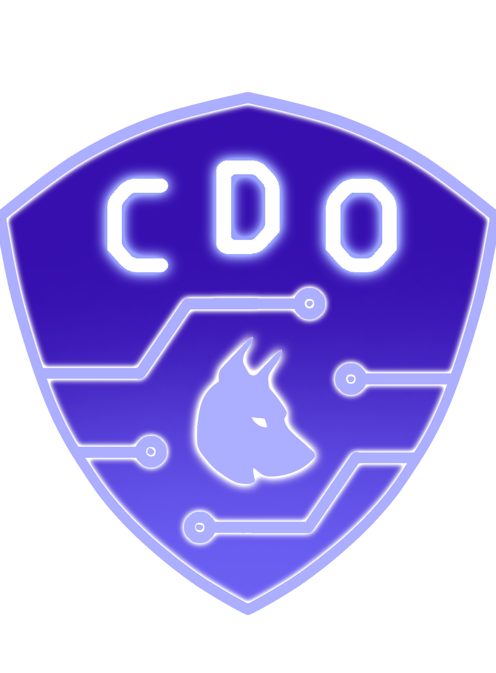
Cyber Defense Organization
Red Team
Active Recon Fall ‘25

Slide 2

Agenda
01
What is Active Recon?
Defining Active Recon and its use in Off. Security
02
Passive vs. Active Recon
Differences between Passive & Active Reconnaissance
03
Understanding Nmap
Understanding the NMAP tool for scanning
04
Common Scanning Tools
Tools used for scanning various services/systems
05
Lab & Closing Remarks

Slide 3
Sign-in QR Code

Slide 4






Topic Week Breakdown
Week05
Week07
Week01
Week03
Risk Matrixes
OSINT (Blue Team Collab)
Initial Access & Exploitation
Persistence & Discovery
Week02
Week06
Week04
Active Reconnaissance
Execution
Lateral Movement & Exfiltration

Slide 5

01
What is Active Recon?
What have we done What information have we found How can we use this to progress
Notes:
Recently been to Shmoo Con in DC, held in-house GDDC and will do so again this semester,

Slide 6

01 – Active Reconnaissance
Active Reconnaissance:
The process of directly interacting with a target system to gather information, often by sending packets or making requests.
Concepts in Active Recon:
- Phishing for Victim Info
- Scanning for Open Web Subdirectories/Domains
- Scanning for Network Information

Slide 7
Active Reconnaissance

Slide 8

02
Passive vs. Active Recon

Slide 9

Let’s define it
Active Reconnaissance:
Passive Reconnaissance:
The process of directly interacting with a target system to gather information, often by sending packets or making requests.
The process of gaining information about targeted computers and networks without actively engaging with the systems.
How does it differ?
Active Scans for open ports, services, and possibly for vulnerabilities using tools like Nmap, Nikto, SQLMap, etc.
Unlike passive recon, it risks being detected by defenders.
Notes:
Provide example scenarios for when a Pen Test would be used as compared to a Red Team engagement.

Slide 10
Now that we know what it is
Let’ understand what it “looks like”

Slide 11

Think of it like this…
Passive Recon:
Active Recon:
Notes:
Provide example scenarios for when a Pen Test would be used as compared to a Red Team engagement.

Slide 12

03
Nmap

Slide 13
03 Nmap – Building the Command
Basic Syntax for Nmap scan:
kali@desktop:: nmap {Target IP(s)} [scan type] [options]
Target IP(s): 127.0.0.1 | 127.0.0.1 192.168.1.5 192.168.1.3 | 192.168.1.0/24 |
Scan Type(s): -sX | -sU | -sS |
Options: --script=“<scriptName>” | -vv | -O | -T1-4 | -A | -sV | -sC | -p- |
Nmap.org/book/man.html - Full documentation

Slide 14
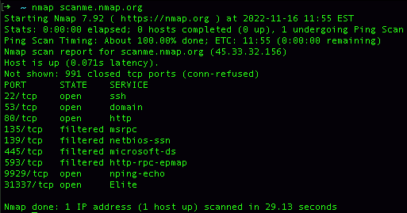

Slide 15
03 Nmap – Test Your Knowledge
Tell me what these scans do:
kali@desktop: nmap 192.168.1.20 -p 80,443,22
kali@desktop: nmap 192.168.1.0/24 –sn –T4 -n
Notes:
Answer: Scanning a single ip on specific ports 80,443, and 22
Answer: Scanning the /24 subnet/network with no port scan (-sn) at speed 4 (-T4) withno dns resolutions (-n)

Slide 16
03 Nmap – Test Your Knowledge 2
Tell me what these scans do:
kali@desktop: nmap 192.168.1.5-150 –v –sV –F
kali@desktop: nmap 127.0.0.1 -sV -O -vV -A -F --script=vuln
Notes:
Answer: Scans a range of IPs for the most common 1000 ports (-F) checks the serviceversion of the open ports (-sV) and prints out to the console in verbose mode (-v)
Answer: Scans a single IP for most common 100 ports (-F) while checking for theOperating System fingerpring (-O) checks the service version of the running serviceson the ports (-sV) while printing the output in Very Verbose mode (-vV). Defaultvulnerabilities are checked with a script (--script=vuln) in an aggressive manner (-A)

Slide 17
We know the services that are running
Lets take continue scanning but with the right tools

Slide 18

04
Common Tools

Slide 19
Useful Scanning Tools
Nikto:
Dirbuster:
Web server vulnerability scanner that checks for outdated software, malicious files, and misconfigurations.
Brute-force tool used to discover hidden directories and files on web servers by crawling URL paths.
SQLMap:
Detecting and exploiting SQL injection vulnerabilities in web applications to gain database information.

Slide 20
Key Takeaway:
Nmap is a tool to be used to see what attack vectors there are
To begin exploiting vulnerabilities you have to first understand each service works to find the flaw or exploit
This is something you learn through self teaching and practice

Slide 21
Next Up​
Special Guest Speaker Meret (10/9)
Meret Wilfurth is a UAlbany Alum with a M.S. in Digital Forensics and Cybersecurity. She will be discussing OSINT and Social engineering.
Exploitation (10/16)
We have covered Active Reconnaissance and how to identify vulnerabilities. Now it is time to learn how to exploit those vulnerabilities and gain access to systems.
Special Guest Speaker TBD (10/23)
We will be having another UAlbany and CDO alum discuss red teaming.

Slide 22
Lab Time!
05

